Slide 1
Day 4 – JavaScript Fundamental

Slide 2
Recap
Let, var and const
Scope (function and block)
if…else statement
If…else if…else statement
Nested conditional
Ternary Operator
Switch statement
Truthy and Falsy value

Slide 3
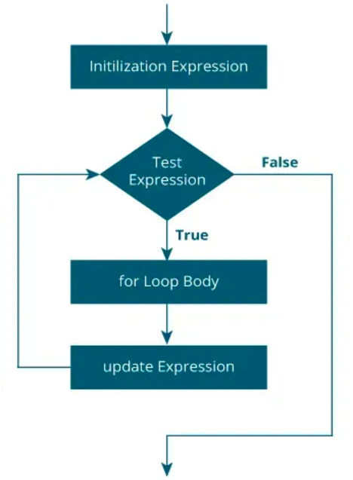
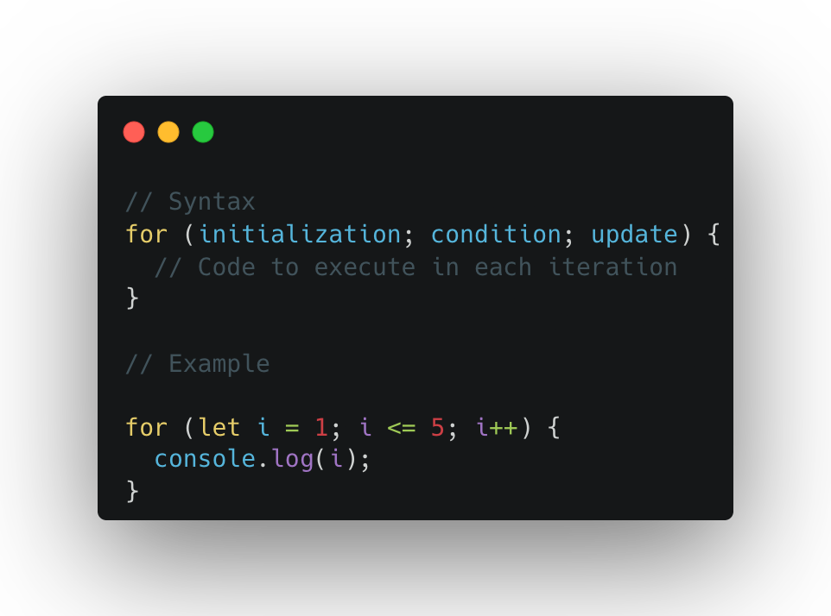
For loop
Notes:
A for loop in JavaScript is used to repeat a block of code a specific number of times. It's one of the most common looping structures and is great for iterating over arrays, numbers, or repetitive tasks.

Slide 4
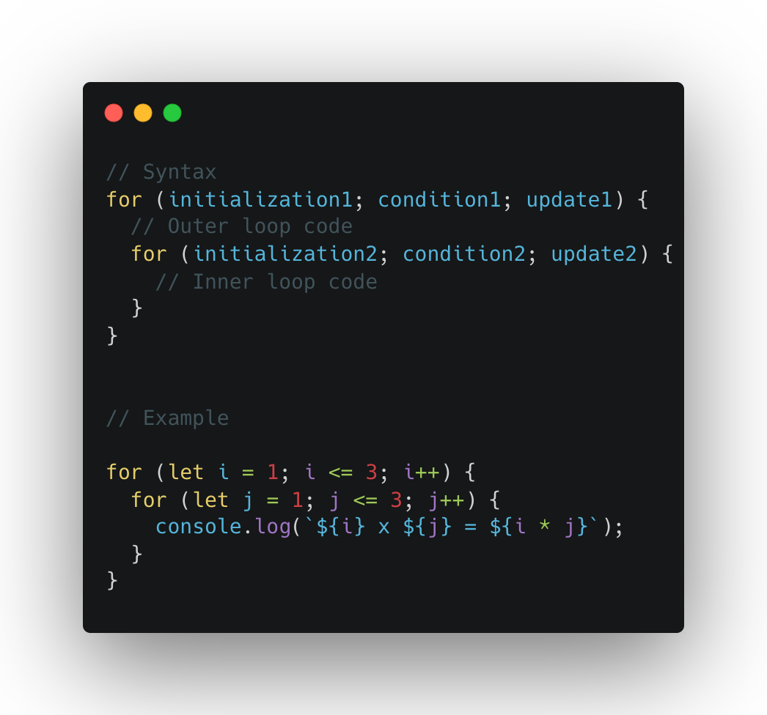
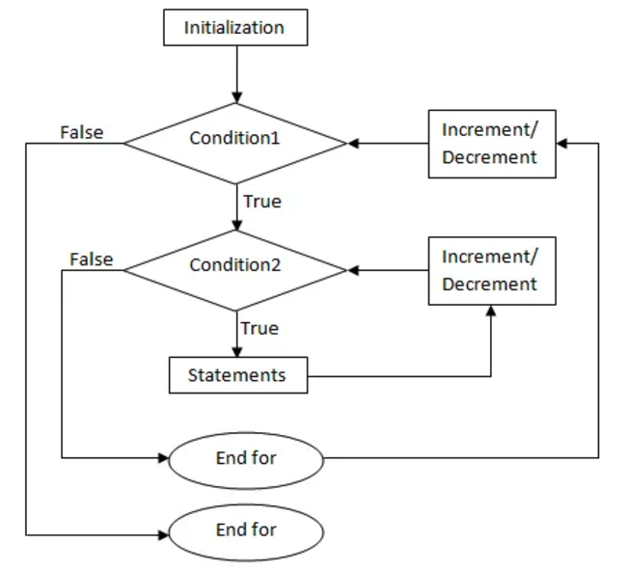
Nested For loop
Notes:
A nested for loop is a for loop inside another for loop. It's commonly used when dealing with multi-dimensional data or scenarios where one set of iterations depends on another.

Slide 5
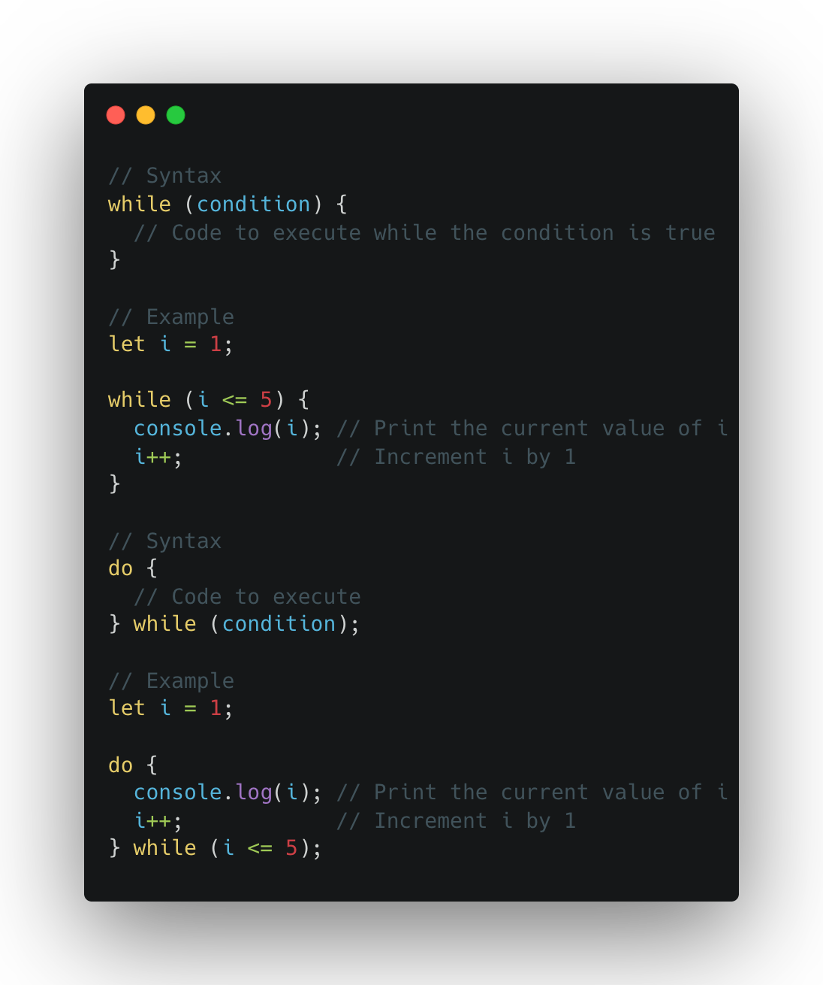
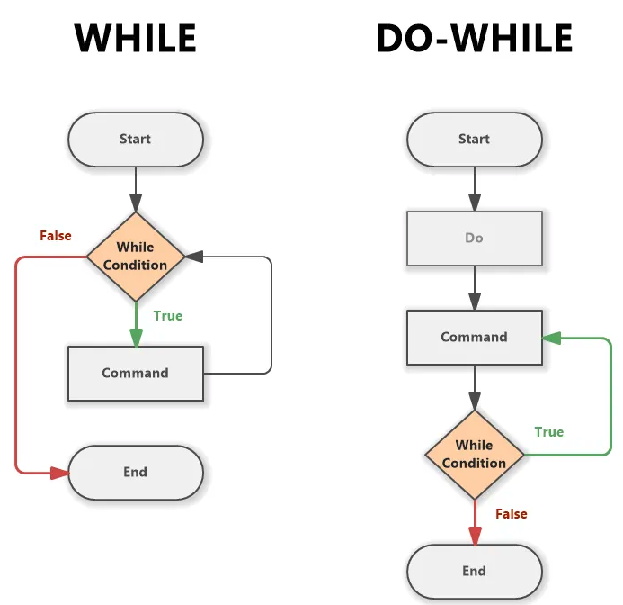
While and do-while loop
Notes:
Both while and do...while loops are used for repeating a block of code based on a condition. The main difference is when the condition is checked:
while loop: Checks the condition before executing the code block.
do...while loop: Executes the code block at least once, then checks the condition.

Slide 6
Break and Continue

Slide 7
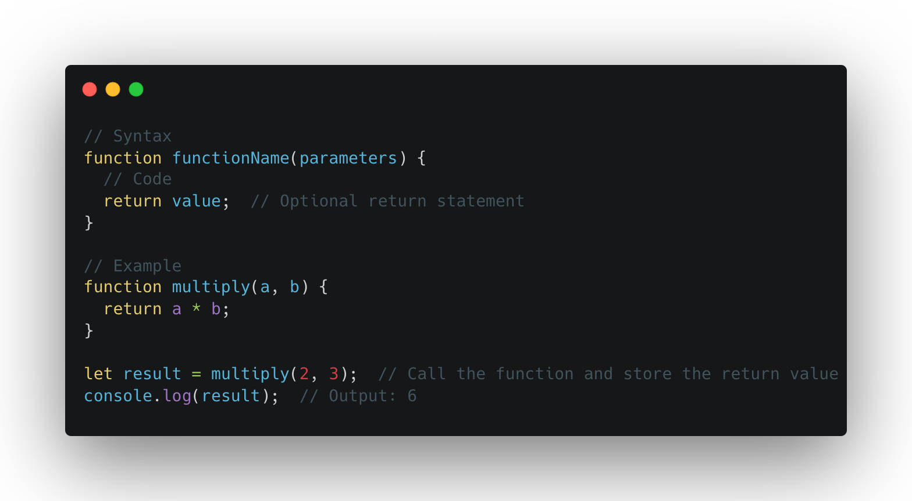
Let’s Intro with Function or Methods
Notes:
A function in JavaScript is a block of reusable code designed to perform a specific task. Functions help to avoid repeating code and make programs more organized.
1. Function Declaration
A function declaration is the most common way to define a function. It uses the function keyword followed by the function name, parameters (optional), and a block of code.
2. Function Call
A function call is when you invoke or "call" a function to execute the code inside it. You call the function by its name followed by parentheses.
3. Function Execution
When a function is executed, the code inside the function runs. The function only executes when it is called. Functions can return a value using the return keyword, or they may perform actions without returning anything.

Slide 8
What is DRY, YAGNI and KISS?
Don’t repeat yourself (reusability and modularity)
Keep It Simple and Straightforward (simplicity and clarity)
You Aren’t Gonna Need IT

Slide 9
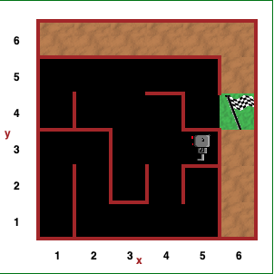
Let’s have some fun now (Game to learn programming)
https://reeborg.ca/index_en.html

Slide 10
Feedback
What went well?
What went wrong?
What did you learn?

Slide 11
Credit
https://carbon.now.sh/

Slide 12
I believe that you learn the most if you don’t learn alone but find learning partners and other people with similar interest. - Unknown

